Slide 1
Improving the maximum attainable accuracy of communication-avoiding Krylov subspace methods
Erin Carson and James Demmel
Householder Symposium XIX
June 8-13, 2014, Spa, Belgium

Slide 2
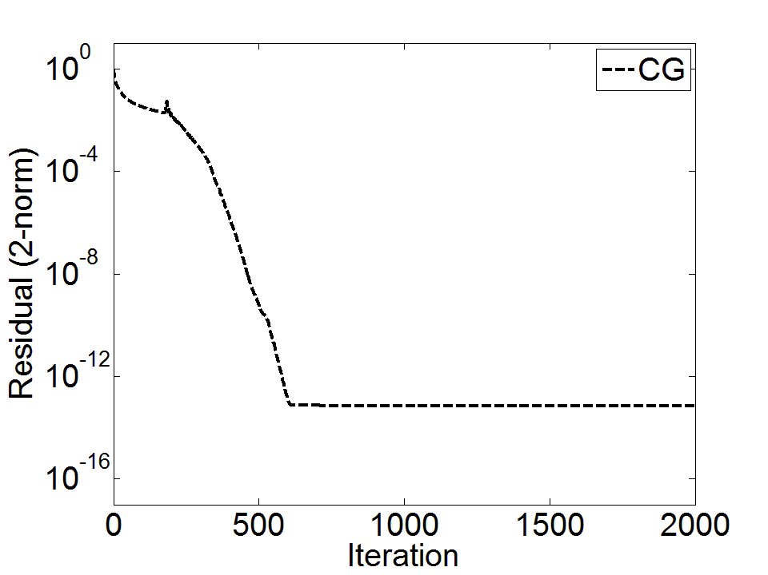
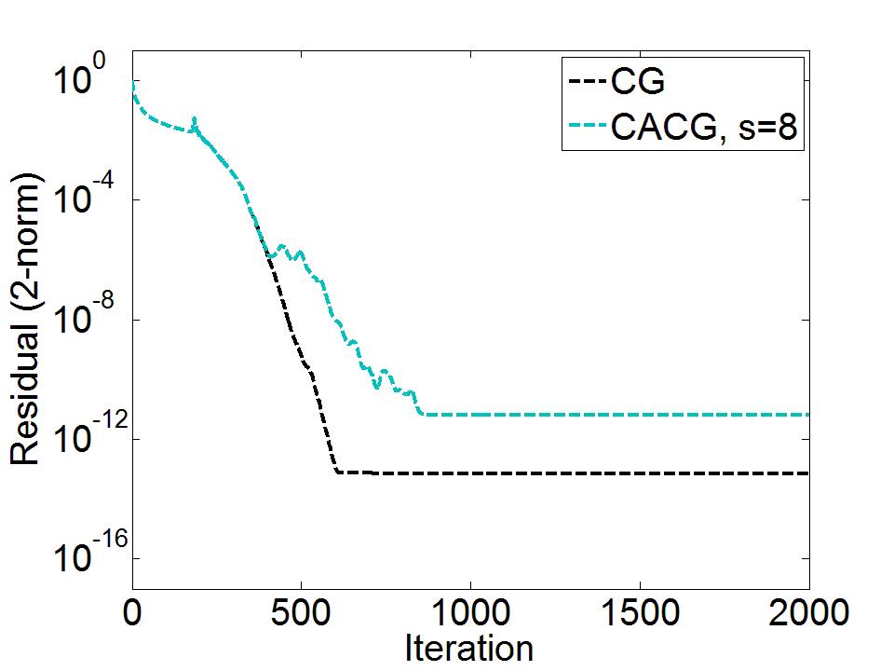
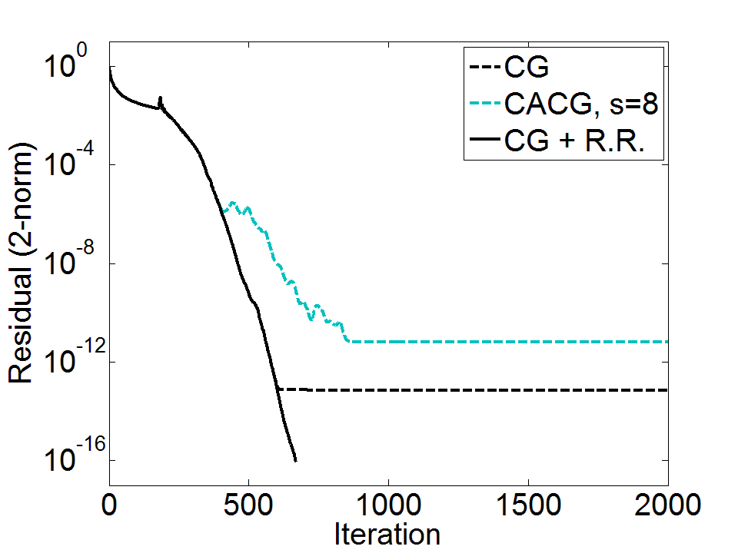
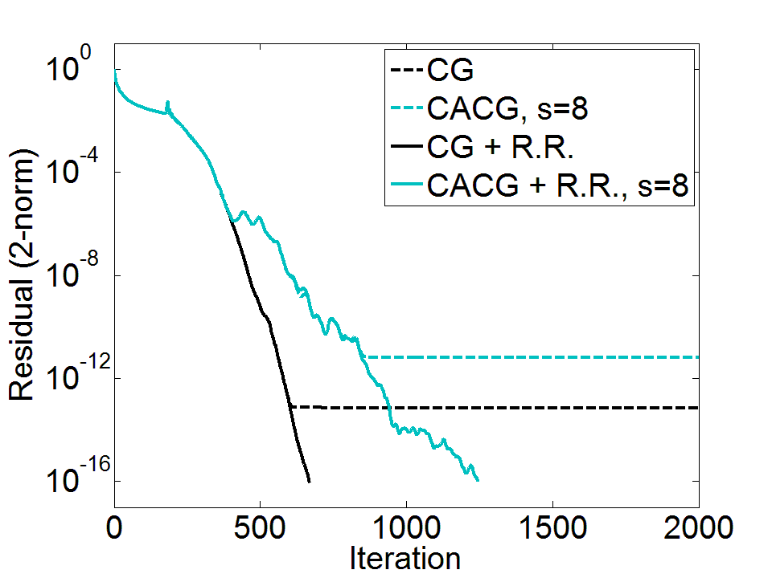
Model Problem: 2D Poisson on ${256}^{2}$ grid, $κ(A)=3.9E4,$ ${\left\|A\right\|}_{2}=1.99$. Equilibration (diagonal scaling) used. RHS set s.t. elements of true solution $x_{i}=1/256$.
We extend this strategy to communication-avoiding variants. Accuracy can be improved for minimal performance cost!
Residual replacement strategy of van der Vorst and Ye (1999) improves attainable accuracy for classical Krylov methods
This affect can be worse for “communication-avoiding” (or $s$-step) Krylov subspace methods – limits practice applicability!
Roundoff error can cause a decrease in attainable accuracy of Krylov subspace methods.

Slide 3
Communication bottleneck in KSMs
A Krylov Subspace Method is a projection process onto the Krylov subspace $𝒦_{m}\left(A,r_{0}\right)=\text{span}\left\{r_{0}, Ar_{0}, A^{2}r_{0}, …, A^{m−1}r_{0}\right\}$ orthogonal to some $ℒ_{m}$.
For linear systems, approx. solution $x_{m}$ to $Ax=b$ by imposing
$x_{m}=x_{0}+δ, δ∈𝒦_{m}$ and $r_{0}−Aδ⊥ℒ_{m}$, where $r_{0}=b−Ax_{0}$.
Projection process in each iteration:
Add a dimension to $𝒦_{m}$
Sparse Matrix-Vector Multiplication (SpMV)
Parallel: comm. vector entries w/ neighbors
Sequential: read $A$/vectors from slow memory
SpMV
orthogonalize
Dependencies between communication-bound kernels in each iteration limit performance!
2. Orthogonalize with respect to $ℒ_{m}$
Inner products
Parallel: global reduction
Sequential: multiple reads/writes to slow memory

Slide 4
Example: Classical conjugate gradient (CG)
$\text{Given}\text{: }\text{initial} approximation x_{0}$ for solving $Ax=b$
Let $p_{0}=r_{0}=b−Ax_{0}$
for $m=1, 2,…,$ until convergence do
$α_{m−1}=\frac{r_{m−1}^{T}r_{m−1}}{p_{m−1}^{T}Ap_{m−1}}$
$x_{m}=x_{m−1}+α_{m−1}p_{m−1}$
$r_{m}=r_{m−1}−α_{m−1}Ap_{m−1}$
$β_{m}=\frac{r_{m}^{T}r_{m}}{r_{m−1}^{T}r_{m−1}}$
$p_{m}=r_{m}+β_{m}p_{m−1}$
end for
SpMVs and inner products require communication in each iteration!

Slide 5
Communication-avoiding CA-KSMs
Krylov methods can be reorganized to reduce communication cost by $O(s)$
Many CA-KSMs (or $s$-step KSMs) derived in the literature: CG, GMRES, Orthomin, MINRES, Lanczos, Arnoldi, CGS, Orthodir, BICG, CGS, BICGSTAB, QMR
Related references:
(Van Rosendale, 1983), (Walker, 1988), (Leland, 1989), (Chronopoulos and Gear, 1989), (Chronopoulos and Kim, 1990, 1992), (Chronopoulos, 1991), (Kim and Chronopoulos, 1991), (Joubert and Carey, 1992), (Bai, Hu, Reichel, 1991), (Erhel, 1995), GMRES (De Sturler, 1991), (De Sturler and Van der Vorst, 1995), (Toledo, 1995), (Chronopoulos and Kinkaid, 2001), (Hoemmen, 2010), (Philippe and Reichel, 2012), (C., Knight, Demmel 2013), (Feuerriegel and Bücker, 2013).
Reduction in communication can translate to speedups on practical problems
Recent results: $4.2$x speedup with $s=4$ for CA-BICGSTAB on GMG bottom-solve ($24,576$ cores, $n={1024}^{3}$ on Cray XE6) (Williams, et al., 2014).
Notes:
4096 processes, each process is 6 way multithreaded
Hopper is a Cray XE6
Mention also many other approaches which give speedups, like pipelined Krylov methods

Slide 6
CA-CG overview
Starting at iteration $sk$ for $k≥0, s>0$, it can be shown that to compute the next $s$steps (iterations $sk+j$ where $j≤s$),
$p_{sk+j},r_{sk+j},x_{sk+j}−x_{sk}∈𝒦_{s+1}\left(A,p_{sk}\right)+𝒦_{s}\left(A,r_{sk}\right)$.
1. Compute matrix $Y_{k}=\left[ρ_{0}\left(A\right)p_{sk},…, ρ_{s}\left(A\right)p_{sk},ρ_{0}\left(A\right)r_{sk},…, ρ_{s−1}\left(A\right)r_{sk}\right]$ of dimension $n$-by-$(2s\text{+}1)$, giving the recurrence relation
$A{\underline{Y}}_{k}=Y_{k}B_{k}$,
where $B_{k}$ is $(2s\text{+}1)$-by-$(2s\text{+}1)$ and is 2x2 block diagonal with upper Hessenberg blocks, and ${\underline{Y}}_{k}$ is $Y_{k}$ with columns $s\text{+}1$ and $2s\text{+}1$ set to 0.
Represent length-$n$ iterates by length-$(2s\text{+}1)$ coordinates in $Y_{k}$:
$$\left[p_{sk+j},r_{sk+j},x_{sk+j}−x_{sk}\right]=Y_{k}\left[p_{k,j}^{′},r_{k,j}^{′},x_{k,j}^{′}\right]$$
Communication cost: Same latency cost as one SpMV using matrix powers kernel (e.g., Hoemmen et al., 2007), assuming sufficient sparsity structure (low diameter)
2. Compute Gram matrix $G_{k}=Y_{k}^{T}Y_{k}$ of dimension $(2s\text{+}1)$-by-$(2s\text{+}1)$.
Communication cost: One reduction

Slide 7
No communication in inner loop!
CA-CG
Compute $Y_{k}$ such that $A{\underline{Y}}_{k}=Y_{k}B_{k}$
CG
Compute $G_{k}=Y_{k}^{T}Y_{k}$
for $j=1,…,s$ do
for $j=1,…,s$ do
$$α_{sk+j−1}=\frac{r_{sk+j−1}^{T}r_{sk+j−1}}{p_{sk+j−1}^{T}Ap_{sk+j−1}}$$
$$x_{sk+j}=x_{sk+j−1}+α_{sk+j−1}p_{sk+j−1}$$
$$r_{sk+j}=r_{sk+j−1}−α_{sk+j−1}Ap_{sk+j−1}$$
$$β_{sk+j}=\frac{r_{sk+j}^{T}r_{sk+j}}{r_{sk+j−1}^{T}r_{sk+j−1}}$$
$$p_{sk+j}=r_{sk+j}\text{+}β_{sk+j}p_{sk+j−1}$$
$$α_{sk+j−1}=\frac{r_{k,j−1}^{′T}G_{k}r_{k,j−1}^{′}}{p_{k,j−1}^{′T}G_{k}B_{k}p_{k,j−1}^{′}}$$
$$x_{k,j}^{′}=x_{k,j−1}^{′}+α_{sk+j−1}p_{k,j−1}^{′}$$
$$r_{k,j}^{′}=r_{k,j−1}^{′}−α_{sk+j−1}B_{k}p_{k,j−1}^{′}$$
$$β_{sk+j}=\frac{r_{k,j}^{′T}G_{k}r_{k,j}^{′}}{r_{k,j−1}^{′T}G_{k}r_{k,j−1}^{′}}$$
$$p_{k,j}^{′}=r_{k,j}^{′}+β_{sk+j}p_{k,j−1}^{′}$$
end for
end for
$$\left[x_{sk+s}\text{−}x_{sk}\text{, }r_{sk+s}, p_{sk+s}\right]=Y_{k}{[x}_{k,s}^{′},r_{k,s}^{′},p_{k,s}^{′}]$$

Slide 8
CA-KSMs in finite precision
CA-KSMs are mathematically equivalent to classical KSMs
But have different behavior in finite precision!
Roundoff errors have two discernable effects:
Loss of attainable accuracy (due to deviation of true residual $b−Ax$ and updated residual $r$)
Delay of convergence (due to perturbation of Lanczos recurrence)
Generally worse with increasing $s$
Obstacle to solving practical problems:
Decrease in attainable accuracy $→$ some problems that KSM can solve can’t be solved with CA variant
Delay of convergence $→$ if # iterations increases more than time per iteration decreases due to CA techniques, no speedup expected!

Slide 9
Maximum attainable accuracy of CG
In classical CG, iterates are updated by
$x_{m}=x_{m−1}+α_{m−1}p_{m−1}$ and $r_{m}=r_{m−1}−α_{m−1}Ap_{m−1}$
Formulas for $x_{m}$ and $r_{m}$ do not depend on each other - rounding errors cause the true residual, ${b−Ax}_{m}$, and the updated residual, $r_{m}$, to deviate
The size of $\left\|b−Ax_{m}−r_{m}\right\|$, determines the maximum attainable accuracy
Write the true residual as ${b−Ax}_{m}=r_{m}−\left(b−Ax_{m}−r_{m}\right)$
Then the size of the true residual is bounded by
$$\left\|b−Ax_{m}\right\|≤\left\|r_{m}\right\|+\left\|b−Ax_{m}−r_{m}\right\|$$
When $\left\|r_{m}\right\|≫\left\|b−Ax_{m}−r_{m}\right\|$, $\left\|r_{m}\right\|$ and $\left\|b−Ax_{m}\right\|$ have similar magnitude
When $\left\|r_{m}\right\|→0$, $\left\|b−Ax_{m}\right\|$ depends on $\left\|b−Ax_{m}−r_{m}\right\|$
Many results on attainable accuracy, e.g.: Greenbaum (1989, 1994, 1997), Sleijpen, van der Vorst and Fokkema (1994), Sleijpen, van der Vorst and Modersitzki (2001), Björck, Elfving and Strakoš (1998) and Gutknecht and Strakoš (2000).

Slide 10
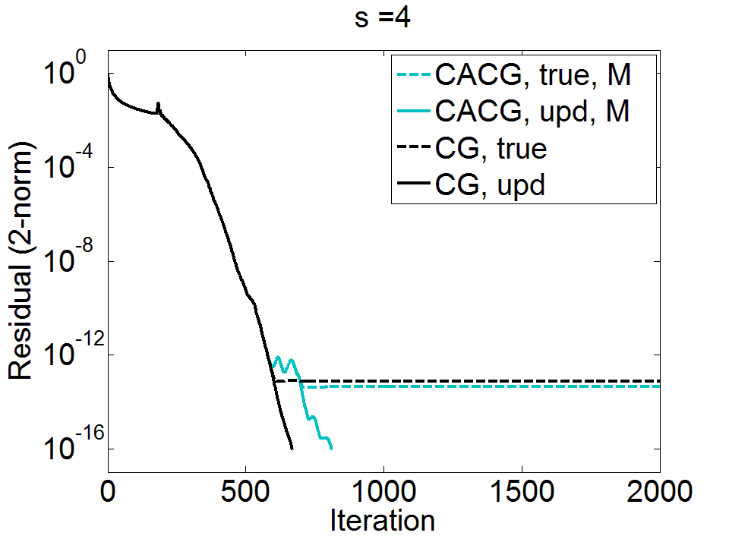
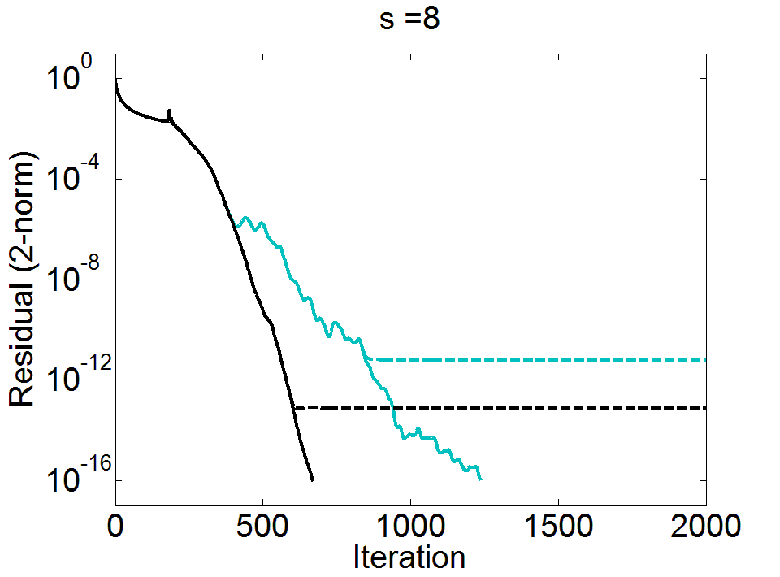
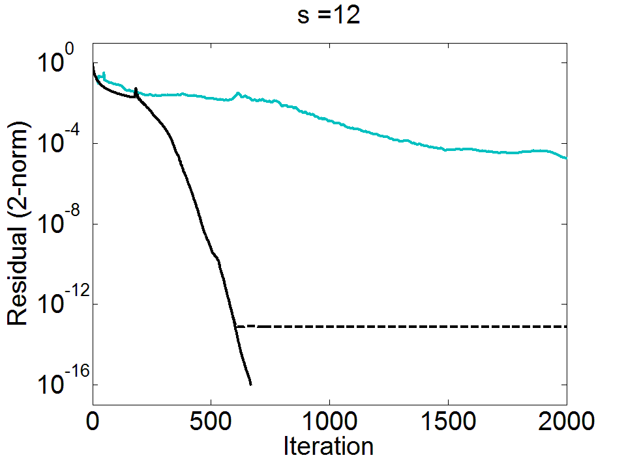
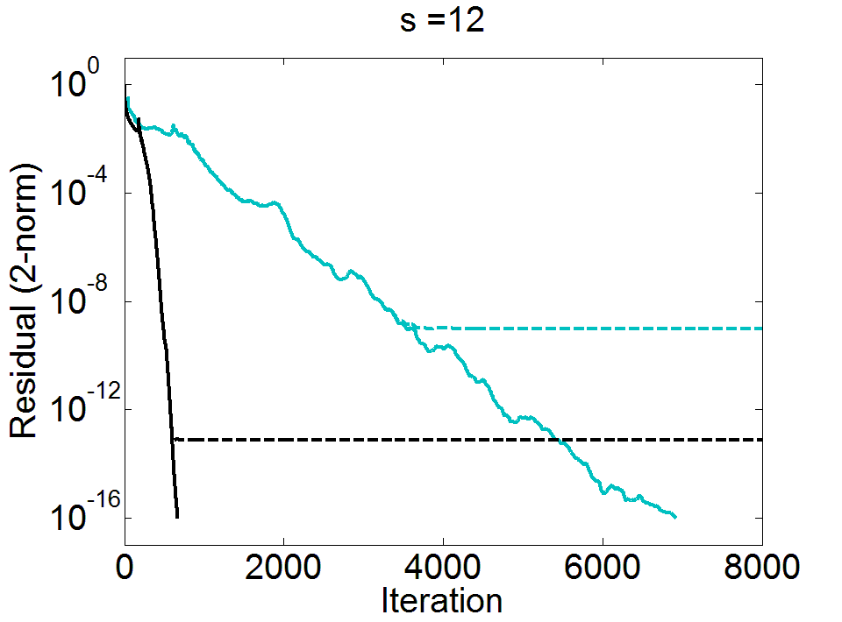
Example: Comparison of convergence of true and updated residuals for CG vs. CA-CG using a monomial basis, for various $s$ values
Model problem (2D Poisson on ${256}^{2}$ grid)

Slide 11
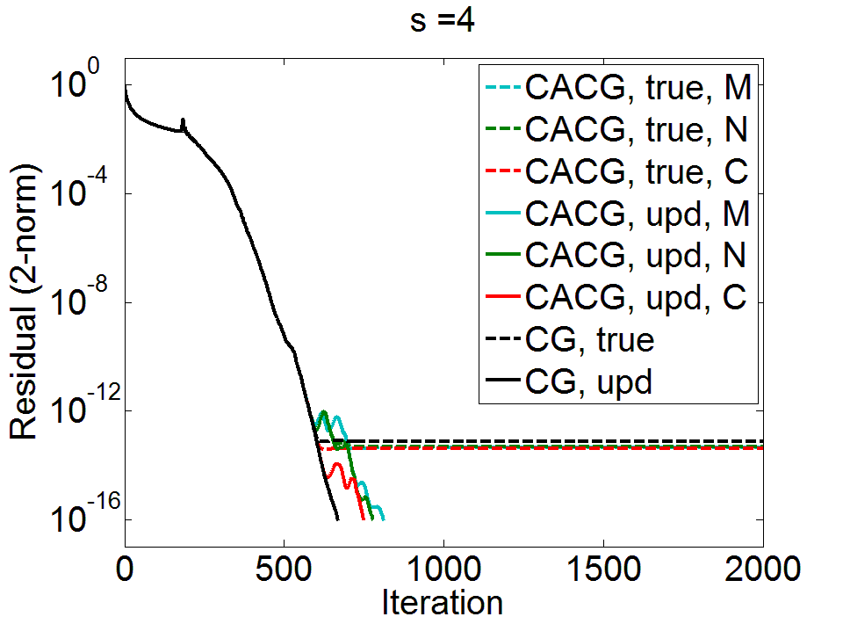
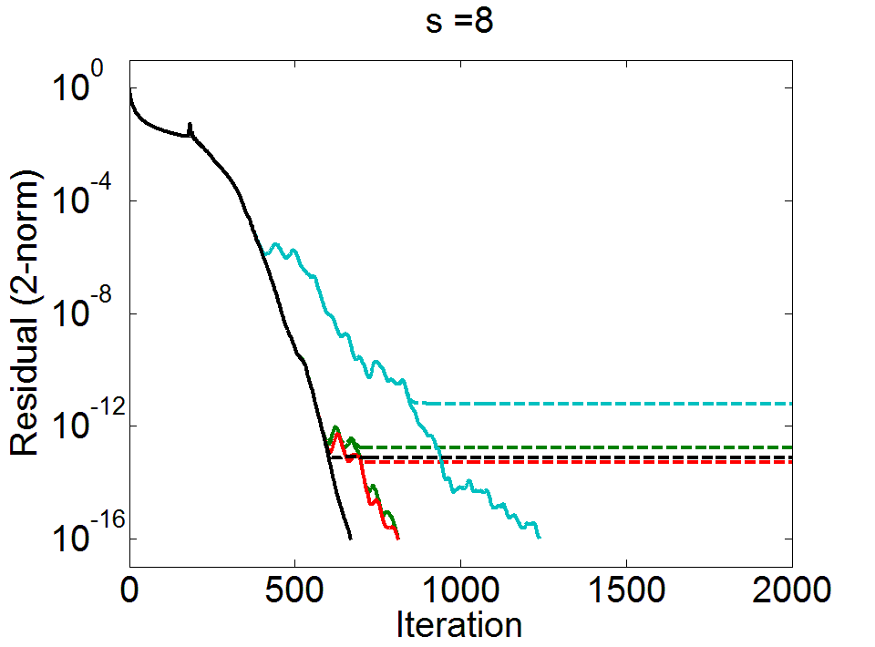
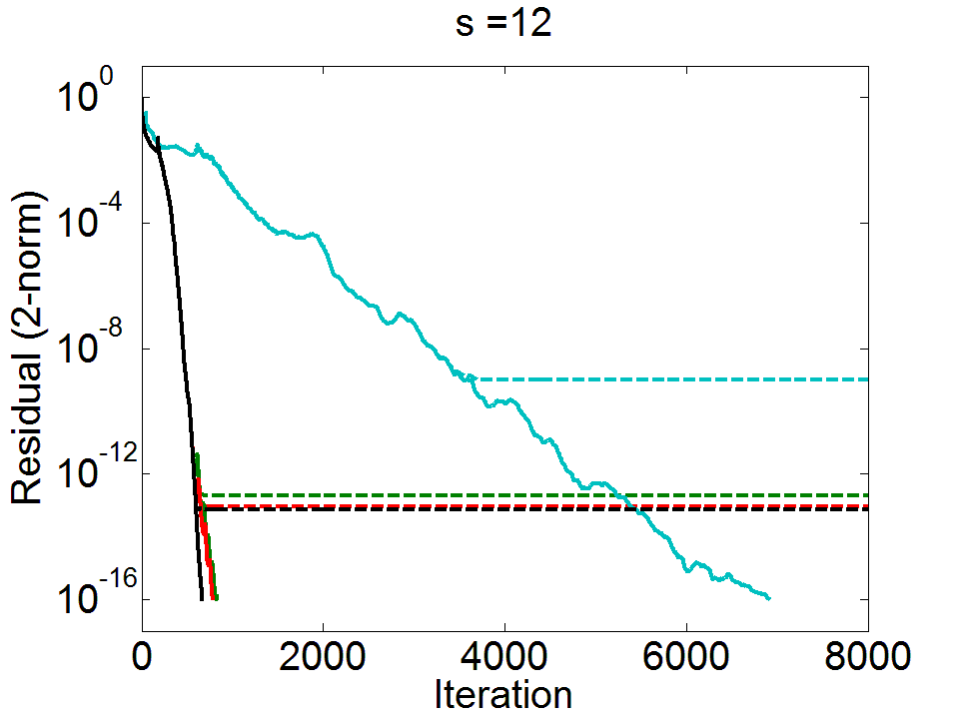
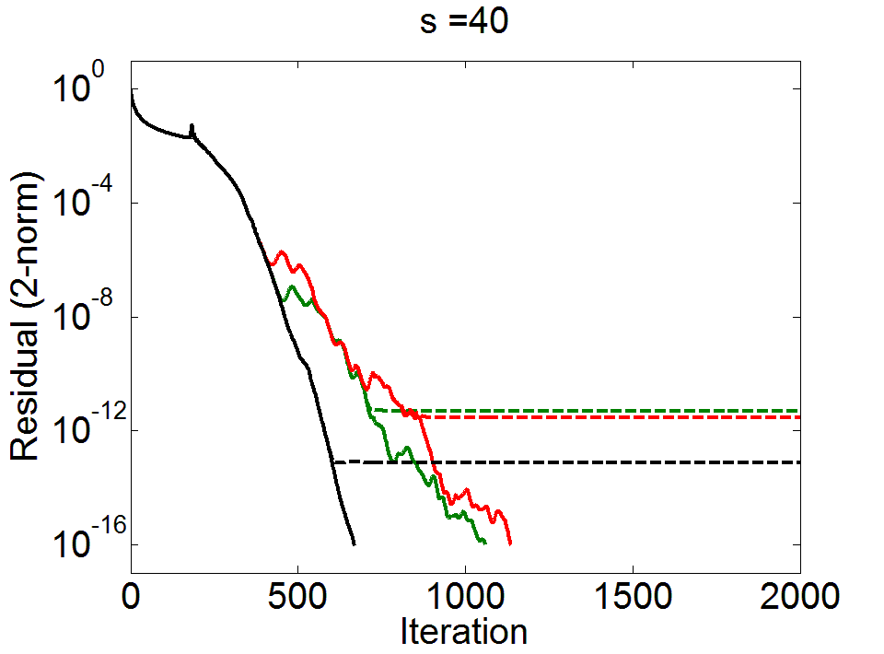
Better conditioned polynomial bases can be used instead of monomial.
Two common choices: Newton and Chebyshev - see, e.g., (Philippe and Reichel, 2012).
Behavior closer to that of classical CG
But can still see some loss of attainable accuracy compared to CG
Clearer for higher $s$ values

Slide 12
Residual replacement strategy for CG
van der Vorst and Ye (1999): Improve accuracy by replacing updated residual $r_{m}$ by the true residual $b−Ax_{m}$ in certain iterations, combined with group update.
Choose when to replace $r_{m}$ with $b−Ax_{m}$ to meet two constraints:
Replace often enough so that at termination, $\left\|b−Ax_{m}−r_{m}\right\|$ is small relative to $εN\left\|A\right\|\left\|x_{m}\right\|$
Don’t replace so often that original convergence mechanism of updated residuals is destroyed (avoid large perturbations to finite precision CG recurrence)
Use computable bound for $\left\|b−Ax_{m}−r_{m}\right\|$ to update error estimate $d_{m}$ in each iteration:
$d_{m}=d_{m−1}+ε\left(\left\|r_{m}\right\|+N\left\|A\right\|\left\|x_{m}\right\|\right)$,
If $d_{m−1}≤\hat{ε}\left\|r_{m−1}\right\| and { d}_{m}>\hat{ε}\left\|r_{m}\right\| and{ d}_{m}>1.1d_{init}$
$z=z+x_{m}$, $x_{m}=0$ (group update), set $r_{m}=b−Az$, set $d_{init}\text{=}ε\left(\left\|r_{m}\right\|\text{+}N\left\|A\right\|\left\|z\right\|\right)$
If updated residual converges to $O(ε)\left\|A\right\|\left\|x\right\|$, true residual reduced to $O(ε)\left\|A\right\|\left\|x\right\|$

Slide 13
Sources of roundoff error in CA-CG
Computing the $s$-step Krylov basis:
$A{\underline{\hat{Y}}}_{k}={\hat{Y}}_{k}B_{k}+∆_{Y_{k}}$
Updating coordinate vectors in the inner loop:
${\hat{x}}_{k,j}^{′}={\hat{x}}_{k,j−1}^{′}+{\hat{q}}_{k,j−1}^{′}+ξ_{k,j}$
${\hat{r}}_{k,j}^{′}=r_{k,j−1}^{′}−B_{k} {\hat{q}}_{k,j−1}^{′}+η_{k,j}$
with ${\hat{q}}_{k,j−1}^{′}=\text{fl}({\hat{α}}_{sk+j−1}{\hat{p}}_{k,j−1}^{′})$
Recovering CG vectors for use in next outer loop:
${\hat{x}}_{sk+j}={\hat{Y}}_{k}{\hat{x}}_{k,j}^{′}+{\hat{x}}_{sk}+φ_{sk+j}$
${\hat{r}}_{sk+j}={\hat{Y}}_{k}{\hat{r}}_{k,j}^{′}+ψ_{sk+j}$
Error in computing $s$-step basis
Error in updating coefficient vectors
Error in
basis change

Slide 14
Maximum attainable accuracy of CA-CG
We can write the deviation of the true and updated residuals in terms of these errors:
$$b\text{−}A{\hat{x}}_{sk+j}\text{−}{\hat{r}}_{sk+j}=b\text{−}Ax_{0}\text{−}r_{0}$$
$$−\sum_{ℓ=0}^{k−1}{\left[Aφ_{sℓ+s}+ψ_{sℓ+s}+\sum_{i=1}^{s}{\left[{{A\hat{Y}}_{ℓ}ξ}_{ℓ,i}+{\hat{Y}}_{ℓ}η_{ℓ,i}−Δ_{Y_{ℓ}}{\hat{q}}_{ℓ,i−1}^{′}\right]}\right]}$$
$$−\sum_{i=1}^{j}{\left[{{A\hat{Y}}_{k}ξ}_{k,i}+{\hat{Y}}_{k}η_{k,i}−Δ_{Y_{k}}{\hat{q}}_{k,i−1}^{′}\right]}−{Aφ}_{sk+j}−ψ_{sk+j}$$
Using standard rounding error results, this allows us to obtain an upper bound on $\left\|b\text{−}A{\hat{x}}_{sk+j}\text{−}{\hat{r}}_{sk+j}\right\|$.
Notes:
This can easily be translated into a norm-wise upper bound using the corresponding upper bounds on the error terms.
We later show one possible way this bound can be used to improve accuracy
(a residual replacement strategy)

Slide 15
A computable bound
We extend van der Vorst and Ye’s residual replacement strategy to CA-CG
Making use of the bound for $\left\|b\text{−}A{\hat{x}}_{sk+j}\text{−}{\hat{r}}_{sk+j}\right\|$ in CA-CG, update error estimate $d_{sk+j}$ by:
All lower order terms in CA-CG $⇒$ Residual replacement does not asymptotically increase communication or computation!
$O(s^{3})$ flops per $s$ iterations; $≤$1 reduction per $s$ iterations
$O(n+s^{3})$ flops per $s$ iterations; no communication
Estimated only once
$d_{sk+j}≡d_{sk+j−1}$
$+ε\left[\left(4\text{+}N′\right)\left(\left\|A\right\| \left\|\left|{\hat{Y}}_{k}\right|\text{∙}\left|{\hat{x}}_{k,j}^{′}\right|\right\|+\left\|\left|{\hat{Y}}_{k}\right|\text{∙}\left|B_{k}\right|\text{∙}\left|{\hat{x}}_{k,j}^{′}\right|\right\|\right)+\left\|\left|{\hat{Y}}_{k}\right|\text{∙}\left|{\hat{r}}_{k,j}^{′}\right|\right\|\right]$
$+ε\left\{\begin{aligned}\left\|A\right\|\left\|{\hat{x}}_{sk+s}\right\|\text{+}\left(2\text{+}2N^{′}\right)\left\|A\right\|\left\|\left|{\hat{Y}}_{k}\right|\text{∙}\left|{\hat{x}}_{k,s}^{′}\right|\right\|\text{+}N^{′}\left\|\left|{\hat{Y}}_{k}\right|\text{∙}\left|{\hat{r}}_{k,s}^{′}\right|\right\|, \\ 0,\end{aligned}\right.$
$$j=s$$
otherwise
where $N^{′}=\max\left(N, 2s+1\right).$

Slide 16
Residual replacement for CA-CG
Use the same replacement condition as van der Vorst and Ye (1999):
$$d_{sk+j−1}≤\hat{ε}\left\|r_{sk+j−1}\right\| and { d}_{sk+j}>\hat{ε}\left\|r_{sk+j}\right\| and{ d}_{sk+j}>1.1d_{init}$$
where $\hat{ε}≈\sqrt{ε}$ is a tolerance parameter, and we initially set
$d_{init}=ε\left(N′\left\|A\right\|\left\|x_{0}\right\|+\left\|r_{0}\right\|\right)$.
Pseudo-code for residual replacement with group update for CA-CG:
if $d_{sk+j−1}≤\hat{ε}\left\|r_{sk+j−1}\right\| and { d}_{sk+j}>\hat{ε}\left\|r_{sk+j}\right\| and{ d}_{sk+j}>1.1d_{init}$
$z=z+Y_{k} x_{k,j}^{′}+x_{sk}$
$x_{sk+j}=0$
$r_{sk+j}=b−Az$
$d_{init}={ d}_{sk+j}=ε\left(\left(1+2N′\right)\left\|A\right\|\left\|z\right\|+\left\|r_{sk+j}\right\|\right)$
$p_{sk+j}=Y_{k}p_{k,j}^{′}$
break from inner loop and begin new outer loop
end

Slide 17
15

Slide 18
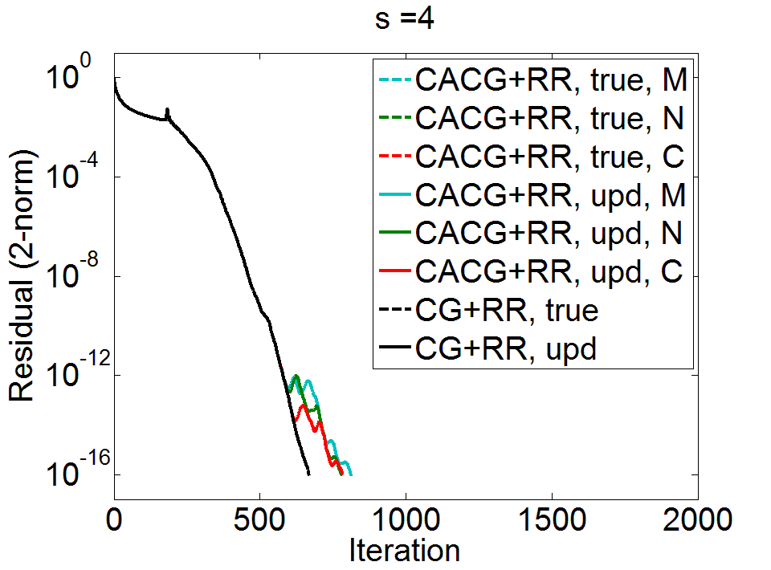
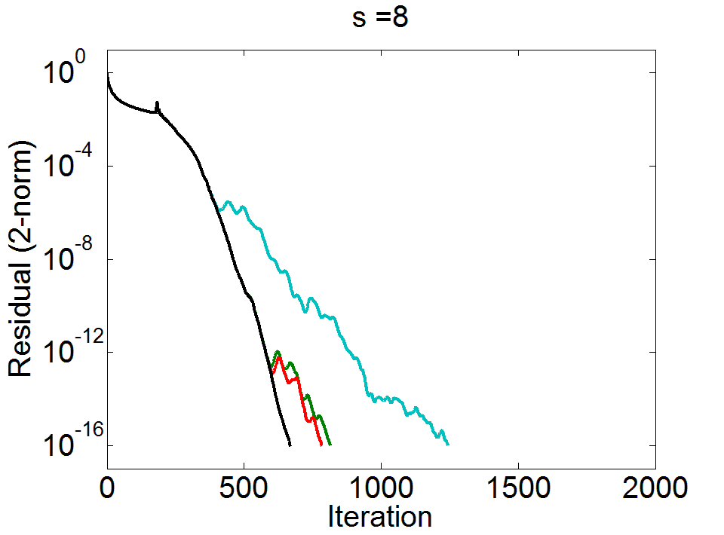
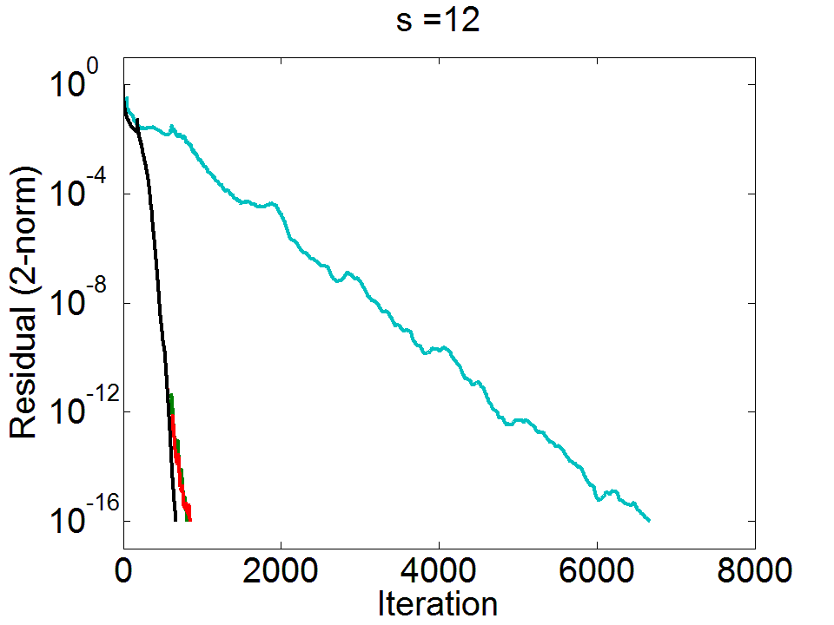
Residual Replacement Indices
Total Number of Reductions
 | CACG Mono. | CACG Newt. | CACG Cheb. | CG
s=4 | 354 | 353 | 365 | 355
s=8 | 224, 334, 401, 517 | 340 | 353
s=12 | 135, 2119 | 326 | 346
 | CACG Mono. | CACG Newt. | CACG Cheb. | CG
s=4 | 203 | 196 | 197 | 669
s=8 | 157 | 102 | 99
s=12 | 557 | 68 | 71
# replacements small compared to total iterations → RR doesn’t significantly affect communication savings!
Can have both speed and accuracy!
In addition to attainable accuracy, convergence rate is incredibly important in practical implementations
Convergence rate depends on basis
15

Slide 19
Current work: CA-Lanczos convergence analysis
$$A{\hat{V}}_{m}={\hat{V}}_{m}{\hat{T}}_{m}+{\hat{β}}_{m+1}{\hat{v}}_{m+1}e_{m}^{T}+δ{\hat{V}}_{m}$$
${\hat{V}}_{m}=\left[{\hat{v}}_{1}, …, {\hat{v}}_{m}\right]$, ${δ\hat{V}}_{m}=\left[δ{\hat{v}}_{1}, …, δ{\hat{v}}_{m}\right]$, ${\hat{T}}_{m}=\left[\begin{matrix}{\hat{α}}_{1} & {\hat{β}}_{2} & & \\ {\hat{β}}_{2} & ⋱ & ⋱ & \\ & ⋱ & ⋱ & {\hat{β}}_{m} \\ & & {\hat{β}}_{m} & {\hat{α}}_{m} \end{matrix}\right]$
for $i∈\{1, …, m\}$,
${\left\|δ{\hat{v}}_{i}\right\|}_{2}≤ε_{1}σ$
${\hat{β}}_{i+1}\left|{\hat{v}}_{i}^{T}{\hat{v}}_{i+1 }\right|≤2ε_{0}σ$
$\left|{\hat{v}}_{i+1}^{T}{\hat{v}}_{i+1}−1 \right|≤{ε_{0}}/2$
$$\left|{\hat{β}}_{i+1 }^{2}+{\hat{α}}_{i}^{2}+{\hat{β}}_{i}^{2}− {\left\|A{\hat{v}}_{i}\right\|}_{2}^{2}\right|≤4i\left(3ε_{0}+ε_{1}\right)σ^{2}$$
Classic Lanczos rounding error result of Paige (1976):
where $σ≡{\left\|A\right\|}_{2}$, $θσ≡{\left\|\left|A\right|\right\|}_{2}$,
$ε_{0}≡2ε\left(n+4\right)<1/12$ and $ε_{1}≡2ε\left(Nθ+7\right)$
$$ε_{0}=O\left(εn\right)$$
$$ε_{1}=O\left(εNθ\right)$$
→ These results form the basis for Paige’s influential results in (Paige, 1980).

Slide 20
Current work: CA-Lanczos convergence analysis
Let $Γ≡\max_{ℓ≤k}{ {\left\|Y_{ℓ}^{+}\right\|}_{2}∙{\left\|\left|Y_{ℓ}\right|\right\|}_{2}≤\left(2s\text{+}1\right)∙\max_{ℓ≤k} κ\left(Y_{ℓ}\right)}.$
for $i∈\{1, …, m\text{=}sk\text{+}j\}$,
${\left\|δ{\hat{v}}_{i}\right\|}_{2}≤ε_{1}σ$
${\hat{β}}_{i+1}\left|{\hat{v}}_{i}^{T}{\hat{v}}_{i+1 }\right|≤2ε_{0}σ$
$\left|{\hat{v}}_{i+1}^{T}{\hat{v}}_{i+1}−1 \right|≤{ε_{0}}/2$
$\left|{\hat{β}}_{i+1 }^{2}+{\hat{α}}_{i}^{2}+{\hat{β}}_{i}^{2}− {\left\|A{\hat{v}}_{i}\right\|}_{2}^{2}\right|≤4i\left(3ε_{0}+ε_{1}\right)σ^{2}$
For CA-Lanczos, we have:
with $ε_{0}≡2ε\left(n\text{+}11s\text{+}15\right) Γ^{2}=O\left(εnΓ^{2}\right)\text{,}$
$ε_{1}≡2ε\left(\left(\text{N}\text{+}2s\text{+}5\right)θ+\left(4s\text{+}9\right)τ\text{ + }10s\text{+}16\right)Γ=O\left(εNθΓ\right)$,
where $σ≡{\left\|A\right\|}_{2},$ $θσ≡{\left\|\left|A\right|\right\|}_{2}$, $τσ≡\max_{ℓ≤k}{{\left\|\left|B_{ℓ}\right|\right\|}_{2}}$
(vs. $O\left(εn\right)$ for Lanczos)
(vs. $O\left(εNθ\right)$ for Lanczos)
If $Y_{ℓ}$ is numerically full rank for $0≤ℓ≤k$ and if $ε_{0}≡2ε\left(n\text{+}11s\text{+}15\right) Γ^{2}≤\frac{1}{12}$, the results of (Paige, 1980) apply to CA-Lanczos (with these news values of $ε_{0}, ε_{1}$).
Confirms the empirically observed effect of basis conditioning on convergence.

Slide 21
Thank you! contact: erin@cs.berkeley.edu http://www.cs.berkeley.edu/~ecc2z/

Slide 22
Extra Slides

Slide 23
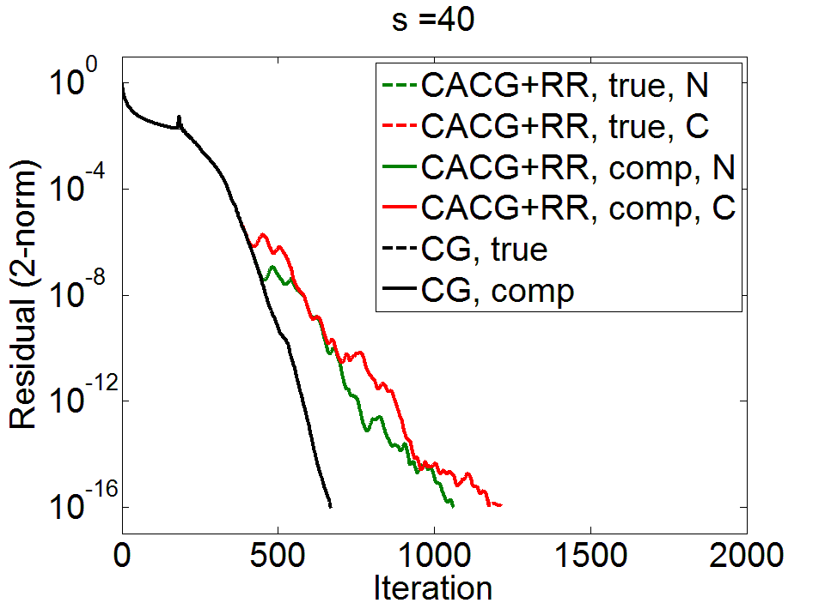
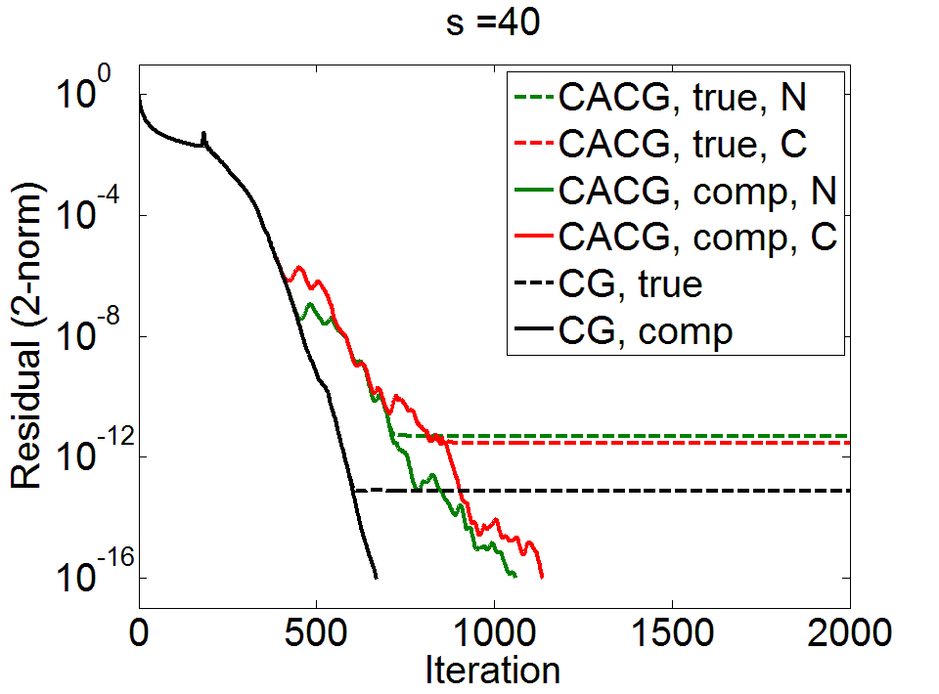
Replacement Iterations
Newton: 240, 374
Chebyshev: 271, 384

Slide 24
Upper bound on maximum attainable accuracy in communication-avoiding Krylov subspace methods in finite precision
Applies to CA-CG and CA-BICG
Implicit residual replacement strategy for maintaining agreement between residuals to within $O\left(ε\left\|A\right\|\left\|x\right\|\right)$
Strategy can be implemented within method without asymptotically increasing communication or computation

Slide 25
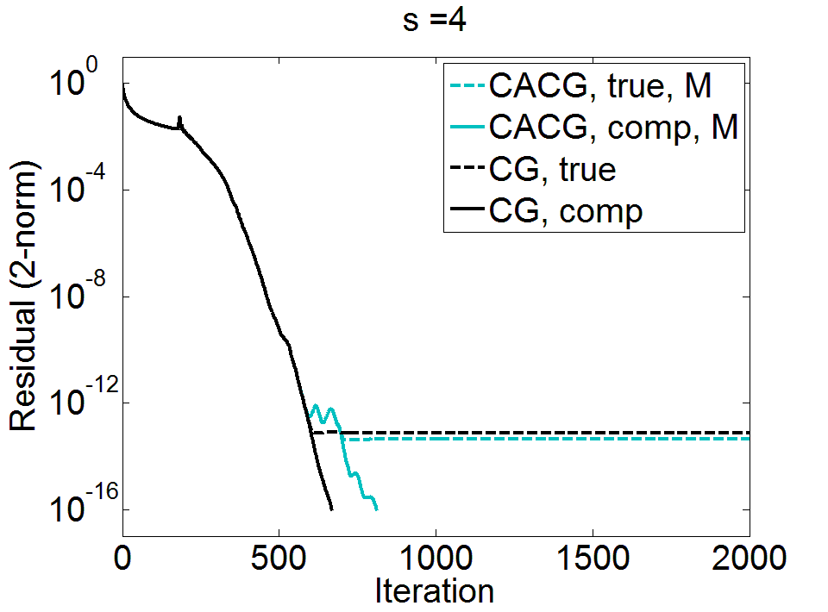

Slide 26
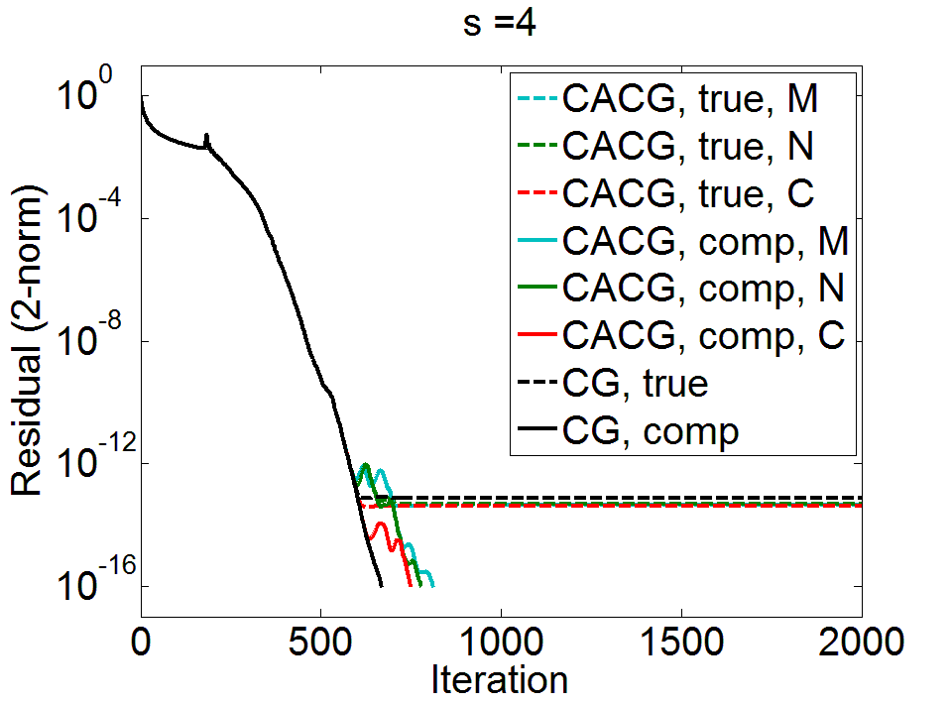
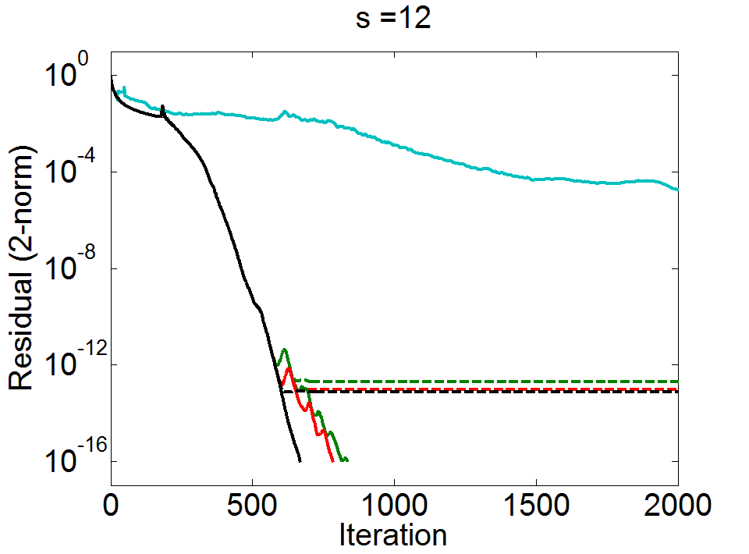

Slide 27
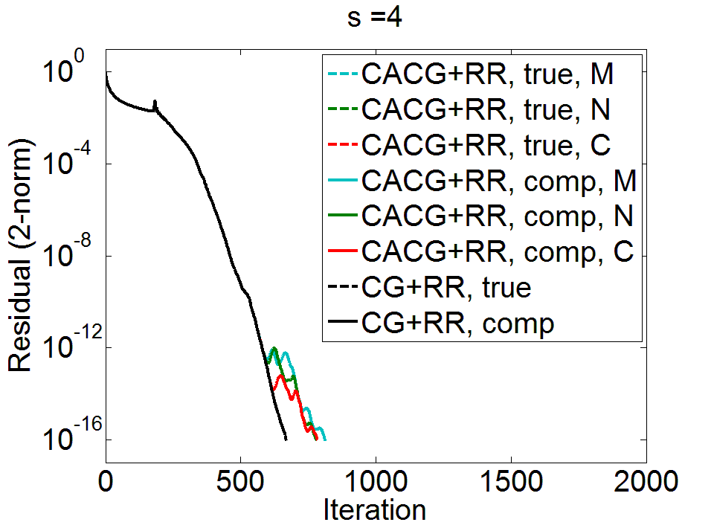
Total Iterations
 | CACG Mono. | CACGNewt. | CACGCheb. | CG
s=4 | 813 | 782 | 785 | 669
s=8 | 1246 | 817 | 785
s=12 | 6675 | 813 | 850

Slide 28
Total Number of Communication Steps
 | CACG Mono. | CACGNewt. | CACGCheb. | CG
s=4 | 203 | 196 | 197 | 669
s=8 | 157 | 102 | 99
s=12 | 557 | 68 | 71

Slide 29
Motivation:
Communication-avoiding, KSM bottleneck, how CA-KSMs work (1)
Speedups, but numerical properties bad (2) – attainable accuracy, convergence
Today focus on attainable accuracy but mention current work related to convergence
Include plots
In order to be practical, numerical properties can’t negate CA benefits
Related work
CA-KSMs (1)
Bounds on attainable accuracy, residual replacement strategies, VdV and Ye (2)
CA-CG derivation (2)
Maximum attainable accuracy bound (1)
Residual replacement strategy of Vdv and Ye (1)
Residual replacement strategy for CA-CG (1)
How can be computed cheaply (1)
Plots (1)
Current work (2): results of Paige and analogous results for CA-case

Slide 30
Improving Maximum Attainable Accuracy in CA-KSMs
Van der Vorst and Ye (1999) : Residual replacement used in combination with group-update of solution vector to improve the maximum attainable accuracy
Given computable upper bound for deviation, replacement steps chosen to satisfy two constraints:
(1) Deviation must not grow so large that attainable accuracy is limited
(2) Replacement must not perturb Lanczos recurrence relation for computed residuals such that convergence deteriorates
When the computed residual converges to level $O(ε)\left\|A\right\|\left\|x\right\|$ but true residual deviates, strategy reduces true residual, to level $O(ε)\left\|A\right\|\left\|x\right\|$
We devise an analogous method for CA-KSMs
Requires determining a computable upper bound for deviation of residuals
In CA-KSMs, we can write the deviation of the true and computed residual as:
$$b−Ax^{sk+j}−r^{sk+j}=b−\left(Ax^{sk+j}+r^{sk+j}\right)$$
$$=b−{\hat{V}}^{k}\left(T^{′}{\hat{e}}^{sk+j}+{\hat{c}}^{sk+j}\right)−A{\hat{x}}^{sk}$$

Slide 31
A Computable Bound
We can bound the deviation of the true and computed residual in CA-CG with residual replacement in each iteration by updating the quantity $d_{sk+j}$ by
$d_{sk+j}≡d_{sk+j−1}+ε\left[\left(1+2N_{T}\right)\left\|T_{k}\right\|\left\|\left|{\hat{V}}_{k}\right|\left|{\hat{x}}_{k,j}^{′}\right|\right\|+\left\|\left|{\hat{V}}^{k}\right|\left|{\hat{r}}_{k,j }^{′}\right|\right\|\right]$
$+ε\left\{\begin{aligned}\left(2+N_{A}\right)\left\|A\right\|\left\|{\hat{x}}_{sk+s}\right\|+N_{V}\left\|A\right\|\left\|\left|{\hat{V}}_{k}\right|\left|{\hat{x}}_{k,j }^{′}\right|\right\| \\ +N_{V}\left\|\left|{\hat{V}}_{k}\right|\left|{\hat{r}}_{k,j }^{′}\right|\right\|, \\ 0,\end{aligned}\right.$
last inner itr.
otherwise

Slide 32
Residual Replacement Strategy
Based on the perturbed Lanczos recurrence (see, e.g. Van der Vorst and Ye, 1999), we should replace the residual when
$$d_{sk+j−1}≤\hat{ε}\left\|r^{sk+j−1}\right\| and { d}_{sk+j}>\hat{ε}\left\|r^{sk+j}\right\| and{ d}_{sk+j}>1.1d_{init}$$
where $\hat{ε}$ is a tolerance parameter, chosen as $\hat{ε}≈\sqrt{ε}$, and
we initially set $d_{init}=ε\left(N_{A} \left\|A\right\|\left\|x_{0}\right\|+\left\|r_{0}\right\|\right)$.
Pseudo-code for residual replacement with group update for CA-CG:
if $d_{sk+j−1}≤\hat{ε}\left\|r_{sk+j−1}\right\| and { d}_{sk+j}>\hat{ε}\left\|r_{sk+j}\right\| and{ d}_{sk+j}>1.1d_{init}$
$z=z+{\hat{V}}_{k} {\hat{x}}_{k,j}^{′}+x_{sk}$
$x_{sk+j}=0$
$r_{sk+j}=b−Az$
$d_{init}={ d}_{sk+j}=ε\left(\left(1+2N_{A}\right)\left\|A\right\|\left\|z\right\|+\left\|r_{sk+j}\right\|\right)$
break from inner loop
end

Slide 33
Communication-avoiding CA-KSMs
Krylov methods can be “reorganized” to reduce communication cost by $O(s)$
Main idea:
Outer Loop k: 1 communication step
Expand Krylov basis by O(s) dimensions up front, stored in matrix $V_{k}$
Same cost as a single SpMVs (for well-partitioned $A$) using matrix powers kernel (see, e.g., Hoemmen et al., 2007)
Compute Gram matrix $G_{k}=V_{k}^{T}V_{k}$: one global reduction
Inner Loop j: $s$ computation steps
Update $\left(2s+1\right)$-vectors of coordinates for $p_{sk+j},r_{sk+j}$, $x_{sk+j}−x_{sk}$ in $V_{k}$
No communication! Quantities either local (parallel) or fit in fast memory (sequential)
Many CA-KSMs (or $s$-step KSMs) derived in the literature: (Van Rosendale, 1983), (Walker, 1988), (Leland, 1989), (Chronopoulos and Gear, 1989), (Chronopoulos and Kim, 1990, 1992), (Chronopoulos, 1991), (Kim and Chronopoulos, 1991), (Joubert and Carey, 1992), (Bai, Hu, Reichel, 1991), (Erhel, 1995), (De Sturler, 1991), (De Sturler and Van der Vorst, 1995), (Toledo, 1995), (Chronopoulos and Kinkaid, 2001), (Hoemmen, 2010).

Slide 34
CA-CG Derivation
Starting at iteration $sk$ for $k≥0, s>0$, it can be shown that for iterations $sk+j$ where $j≤s$,
$p_{sk+j},r_{sk+j}∈𝒦_{s+1}\left(A,p_{sk}\right)+𝒦_{s}\left(A,r_{sk}\right)$
$x_{sk+j}−x_{sk}∈𝒦_{s}\left(A,p_{sk}\right)+𝒦_{s−1}\left(A,r_{sk}\right)$
Define the $n×O(s)$ basis matrices
$P_{s+1}=\left[ρ_{0}\left(A\right)p_{sk},…,ρ_{s}\left(A\right)p_{sk}\right]$, where $\text{span}\left(P_{s+1}\right)=𝒦_{s+1}\left(A,p_{sk}\right)$,
$R_{s}=\left[ρ_{0}\left(A\right)r_{sk},…,ρ_{s−1}\left(A\right)r_{sk}\right]$, where $\text{span}\left(R_{s}\right)=𝒦_{s}\left(A,r_{sk}\right)$,
where $ρ_{j}\left(z\right)$ is a polynomial of degree$j$ satisfying
$ρ_{0}\left(z\right)=1,ρ_{1}\left(z\right)=(z−{\hat{α}}_{0})ρ_{0}(z)/{\hat{γ}}_{0}$,
$$ρ_{j}\left(z\right)=(\left(z−{\hat{α}}_{j−1}\right)ρ_{j−1}\left(z\right)−{\hat{β}}_{j−2}ρ_{j−2}\left(z\right))/{\hat{γ}}_{0}$$
This allows us to write
$AP_{s}=P_{s+1}T_{s+1}$, $AR_{s−1}=R_{s}T_{s}$

Slide 35
CA-CG Derivation
Let $V_{k}=[P_{s+1},R_{s}]$, $G_{k}=V_{k}^{T}V_{k}$, and $T_{k}=\left[\begin{matrix}T_{s+1} & 0 \\ 0 & T_{s}\end{matrix}\right]$.
Then we see that we can represent iterates by their coordinates in $V_{k}$:
$x_{sk+j}−x_{sk}=V_{k}x_{j}^{′}$, $p_{sk+j}=V_{k}p_{j}^{′}$, $r_{sk+j}=V_{k}r_{j}^{′}$
and multiplication by $A$ can be written:
$$Ap_{sk+j}= AV_{k}p_{j}^{′}=V_{k}T_{k}p_{j}^{′}$$
Then after computing $V_{k}$ and $G_{k}$, for iterations $sk+j$, $j < s$,
Inner products can be written:
$r_{sk+j}^{T}r_{sk+j}={r_{j}^{′}}^{T}V_{k}^{T}V_{k}r_{j}^{′}=r_{j}^{′T}G_{k}r_{j}^{′}$
$p_{sk+j}^{T}Ap_{sk+j}={p_{j}^{′}}^{T}V_{k}^{T}V_{k}T_{k}p_{j}^{′}=p_{j}^{′T}G_{k}T_{k}p_{j}^{′}$
Vector updates done implicitly by updating coordinates:
$x_{j+1}^{′}=x_{j}^{′}+α_{sk+j}p_{j}^{′}$
$r_{j+1}^{′}=r_{j}^{′}−α_{sk+j}T_{k}p_{j}^{′}$
$p_{j+1}^{′}=r_{j+1}^{′}+β_{sk+j}p_{j}^{′}$
Computing $V_{k}$: Matrix powers kernel, same communication cost as 1 SpMV for well-partitioned $A$
Computing $G_{k}$: one global reduction
No communication for $s$ iterations!
All small $O\left(s\right)$-dimensional: local/fit in cache.

Slide 36
Example: CA-CG
$\text{Given}\text{: }\text{initial} approximation x_{0}$ for solving $Ax=b$
Let $p_{0}=r_{0}=b−Ax_{0}$
for $k=0, 1, …,$ until convergence do
Compute $V_{k}$ and $G_{k}=V_{k}^{T}V_{k}$
Let $x_{0}^{′}=0_{2s+1}, r_{0}^{′}=e_{s+2}, p_{0}^{′}=e_{1}$
for $j=0,…,s−1$ do
$α_{sk+j}=\frac{{r_{j}^{′}}^{T}G_{k}r_{j}^{′}}{{r_{j}^{′}}^{T}G_{k}T_{k}p_{j}^{′}}$
$x_{j+1}^{′}=x_{j}^{′}+α_{sk+j}p_{j}^{′}$
$r_{j+1}^{′}=r_{j}^{′}−α_{sk+j}T_{k}p_{j}^{′}$
$β_{sk+j+1}=\frac{{r_{j+1}^{′}}^{T}G_{k}r_{j+1}^{′}}{{r_{j}^{′}}^{T}G_{k}r_{j}^{′}}$
$p_{j+1}^{′}=r_{j+1}^{′}+β_{sk+j+1}p_{j}^{′}$
end for
Recover $x_{sk+s}=V_{k}x_{s}^{′}+x_{sk}$, $r_{sk+s}=V_{k}r_{s}^{′}$, $p_{sk+s}=V_{k}p_{s}^{′}$
end for
via CA Matrix Powers Kernel
Global reduction to compute $G_{k}$
Local computations within inner loop require no communication!

Slide 37
Related Work: $s$-step methods
Authors | KSM | Basis | Precond? | Mtx Pwrs? | TSQR?
Van Rosendale, 1983 | CG | Monomial | Polynomial | No | No
Leland, 1989 | CG | Monomial | Polynomial | No | No
Walker, 1988 | GMRES | Monomial | None | No | No
Chronopoulos and Gear, 1989 | CG | Monomial | None | No | No
Chronopoulos and Kim, 1990 | Orthomin, GMRES | Monomial | None | No | No
Chronopoulos, 1991 | MINRES | Monomial | None | No | No
Kim and Chronopoulos, 1991 | Symm. Lanczos, Arnoldi | Monomial | None | No | No
de Sturler, 1991 | GMRES | Chebyshev | None | No | No

Slide 38
Related Work: $s$-step methods
Authors | KSM | Basis | Precond? | Mtx Pwrs? | TSQR?
Joubert and Carey, 1992 | GMRES | Chebyshev | No | Yes* | No
Chronopoulos and Kim, 1992 | Nonsymm. Lanczos | Monomial | No | No | No
Bai, Hu, and Reichel, 1991 | GMRES | Newton | No | No | No
Erhel, 1995 | GMRES | Newton | No | No | No
de Sturler and van der Vorst, 2005 | GMRES | Chebyshev | General | No | No
Toledo, 1995 | CG | Monomial | Polynomial | Yes* | No
Chronopoulos and Swanson, 1990 | CGR, Orthomin | Monomial | No | No | No
Chronopoulos and Kinkaid, 2001 | Orthodir | Monomial | No | No | No

Slide 39
Communication bottleneck in KSMs
A Krylov Subspace Method is a projection process onto the Krylov subspace $𝒦_{m}\left(A,r_{0}\right)=\text{span}\left\{r_{0}, Ar_{0}, A^{2}r_{0}, …, A^{m−1}r_{0}\right\}$ orthogonal to some $ℒ_{m}$.
For linear systems, approx. solution $x_{m}$ to $Ax=b$ by imposing
$x_{m}=x_{0}+δ, δ∈𝒦_{m}$ and $r_{0}−Aδ⊥ℒ_{m}$, where $r_{0}=b−Ax_{0}$.
Projection process in each iteration:
Add a dimension to $𝒦_{m}$
Sparse Matrix-Vector Multiplication (SpMV)
Parallel: comm. vector entries w/ neighbors
Sequential: read $A$/vectors from slow memory
SpMV
orthogonalize
Dependencies between communication-bound kernels in each iteration limit performance!
2. Orthogonalize with respect to $ℒ_{m}$
Inner products
Parallel: global reduction
Sequential: multiple reads/writes to slow memory

Slide 40
Residual replacement strategy for CG
Van der Vorst and Ye (1999): Improve accuracy by replacing updated residual $r_{m}$ by the true residual $b−Ax_{m}$ in certain iterations, combined with group update.
Bound error $η_{m}$ in residual update with residual replacement scheme:
$$r_{m}=r_{m−1}−α_{m−1}Ap_{m−1} +η_{m}$$
$\left\|η_{m}\right\|$ gives an upper bound for $\left\|b−Ax_{m}−r_{m}\right\|$
Want to replace $r_{m}$ with $b−Ax_{m}$ whenever
$\left\|b−Ax_{m}−r_{m}\right\|$ has grown significantly since last replacement step, and
$\left\|η_{m}\right\|/\min\left\{\left\|r_{m}\right\|, \left\|r_{m−1}\right\|\right\}$ is not much larger than $\hat{ε}≈\sqrt{ε}$ (avoid large perturbations to finite precision CG recurrence)
Update $d_{m}$, an estimate of $\left\|η_{m}\right\|$ (and bound for $\left\|b−Ax_{m}−r_{m}\right\|$), in each iteration:
$d_{m}=d_{m−1}+ε N\left\|A\right\| \left\|x_{m}\right\|+ε\left\|r_{m}\right\|$,
where $N$ is the maximal # non-zeros per row of $A$
If $d_{m−1}≤\hat{ε}\left\|r_{m−1}\right\| and { d}_{m}>\hat{ε}\left\|r_{m}\right\| and{ d}_{m}>1.1d_{init}$
$z=z+x_{m}$, $x_{m}=0$ (group update), set $r_{m}=b−Az$, set $d_{init}=\left\|\left(b\text{−}Az\right)\text{−}\text{fl}(b\text{−}Az)\right\|$
If updated residual converges to $O(ε)\left\|A\right\|\left\|x\right\|$, true residual reduced to $O(ε)\left\|A\right\|\left\|x\right\|$

Slide 41
Communication and computation costs
We can compute the terms we need in calculation of $d_{sk+j}$ as follows:
$$\left\|A\right\|$$
Estimated only once at the start of the algorithm.
$\left\|B_{k}\right\|$
Computed once per outer loop – no communication.
All lower order terms in context of CA-CG algorithm
$⇒$ Residual Replacement Strategy does not asymptotically increase communication or computation costs!
Can be estimated using Gram matrix:
${\left\|{\hat{x}}_{sk+j}\right\|}_{2}≤\sqrt{{\hat{x}}_{k,j}^{′T}{\hat{G}}_{k}{\hat{x}}_{k,j}^{′T}}+{\left\|{\hat{x}}_{sk}\right\|}_{2}+O(ε)$ and
${\left\|{\hat{r}}_{sk+j}\right\|}_{2} ≤\sqrt{{\hat{r}}_{k,j}^{′T}{\hat{G}}_{k} {\hat{r}}_{k,j}^{′T}}+O(ε)$
where ${\left\|{\hat{x}}_{sk}\right\|}_{2}$ is available from a previous iteration. No additional communication is needed, and additional computation cost is $O(n+s^{3})$ per outer loop.
$$\left\|{\hat{x}}_{sk+j}\right\|$$
$$\left\|{\hat{r}}_{sk+j}\right\|$$
If we compute ${\hat{G}}_{k}^{′}= {\left|{\hat{Y}}_{k}\right|}^{T}{\left|{\hat{Y}}_{k}\right|}^{ }$ at the start of each outer loop, we can compute these quantities in each inner loop in the 2-norm for a factor of $O(s^{3})$ additional communication per outer loop (a lower order term).
If we can compute ${\hat{G}}_{k}^{′}$ in the same reduction step to compute ${\hat{G}}_{k}$, the latency cost is not affected (otherwise 1 extra message).
$\left\|\left|{\hat{Y}}_{k}\right|\left|{\hat{x}}_{k,j}^{′} \right|\right\|$
$\left\|\left|{\hat{Y}}_{k}\right|\left|{\hat{r}}_{k,j}^{′}\right|\right\|$

